Slide 1
23-24 Cochiti School Budget Presentation
Budget Process for the 23-24 included stakeholder input (Staff and Parents) to create the budget.
Data Collection included: surveys and staff meeting
Staff Input (Plus/Delta 22-23 SY)

Slide 2
Summary Of Current Student
Data for 22-23
Data on Teacher Performance/Mindset
Lack of urgency of academic improvement
Low self-esteem or judgment on self
Don’t want to work over contract time
Need support in Engagement, rigor of work assigned and student academic achievement
Teach bell to bell
February Istation Reading and Math
Grade Band | Reading On target | Reading Not At Target | Math On target | Math Not At Target
K-2 (75) | 14/ 18% | 61/ 81% | 24/ 32% | 51/ 68%
3-5 (78 ) | 22/ 28% | 56/ 72% | 4/ 5% | 74/ 95%
MOY IMSSA Reading, Math, & Lang. Usage
Grade | Reading On Target | Reading Not At Target | Lang. Usage On target | Lang. Usage Not At Target | Math On target | Math Not At Target
6 (28) | 5/18% | 22/ 79% | 5/ 18% | 23/ 82% | 1/ 1% | 27/ 96%
7 (26) | 4/ 15% | 22/ 85% | 6/ 23% | 20/ 77% | 1/1% | 25/ 96%
8 (24) | 5/ 21% | 19/ 79% | 3/ 13% | 21/ 88% | 3/ 13% | 21/ 88%
Data on Student Performance
Low Endurance or grit
Low self-esteem
More depression and anxiety
Background Knowledge of world outside the local communities
Urgency of academic improvement
Low work ethic
Lack of Instruction (Covid and absences)

Slide 3
Parent Priorities for the 2023-2024 SY
 | Very Important | Important | Somewhat Important | Not Important
Student Learning | 95% | 5%
Student Safety | 95% | 5%
Anti-Bullying Programs, Positive Behavior Support | 95% | 5%
Additional Instructional Time to Make Up for Learning Lost Due to Pandemic | 82% | 13% | 5%
Mental Health & Social Emotional Learning (SEL) | 82% | 18%
Native & Spanish and Culture | 77% | 23%
After School Activities | 77% | 23%
Classroom Supplies & Materials for Student Use | 73% | 27%
Fine Arts: Music, Art, Band (etc) | 73% | 27%
Technology (Computers, Chromebooks, Internet, Hot Spots,etc | 68% | 27% |  | 5%
After School Tutoring | 68% | 32%
Athletics | 68% | 32%
Development of Career & Technical Education Programs | 63% | 36%

Slide 4
Projected 23-24 Cochiti Staff and Student Info
K-2 Staff | Students | 3-5 Staff | Students | MSStaff | Students | Elective/Intervention/Language | Instructional Support
Kinder-(1) | K-11 | 3rd- (1) | 3rd-18 | Lang. Arts-(1) CSLD Reading (1) | 6th-20 | Music (½ Time) *Requesting Full Time Garden (½ Time) *Requesting Full Time Art (1 Teacher) CTE (1 Teacher) | Spec Ed Elem (1) MS (1) EAs-(3) MG 3-5 RC 6-8 NM 3-5
1st- (2) | 1st-27 | 4th (2) | 4th-32 | Math- (1) Science (1) | 7th-28 | COC Keres (2) SD Keres (1) (need 2nd teacher) Reading Intervention (1) Social Workers (1 Full Time, 1 Contract SEL Social Worker) | PreK- 1 Tchr 1 EA
2nd- (2) | 2nd-30 | 5th- (1) | 5th-26 | SS-(1) | 8th-26 | Spanish (1) | Health Aide (1) Custodians (2) Registrar-1 Bookkeeper-1

Slide 5
BPS Strategic Goal #1 High Quality, Culturally Sustaining Learning Experiences
Build capacity with teachers to implement strong Tier, Culturally Relevant Instruction for ALL students
90 Day Plan Goals: Increase reading & math proficiency for all students by 10% by the end of May 2024 (Lever 1B)
Garden Teacher-to help improve background knowledge in “funds of knowledge,” cultural connections, and scientific knowledge. We would like to bring in local farms and resources to enhance agricultural possibilities and careers “students’ views of themselves as competent, related, and autonomous in the garden, as well as their engagement and re-engagement in the garden, as potential pathways by which garden-based science activities can shape science motivation, learning, and academic identity in science.” https://stemeducationjournal.springeropen.com/articles/10.1186/s40594-018-0104-9
Music Teacher-“It is believed that students who spend school time in music classes, rather than in further developing their skills in math, science and English classes, will underperform in those disciplines. Our research suggests that, in fact, the more they study music, the better they do in those subjects.” Journal of Educational Psychology-https://www.apa.org/news/press/releases/2019/06/music-students-score-better
Keres and Spanish Teachers Culturally Relevant Pedagogy helps students to uphold their cultural identities while developing fluency in at least one other culture.
-develop a committee to develop school wide plan for 2024-2025
-evaluate the school programs and how Cochiti is supporting students in the area

Slide 6
BPS Strategic Lever 1A- Teacher Support
Tier 1 Support | Description | Cost
Savvas PD (In District) Math & Reading | Additional Compensation Substitute Coverage Contract Services | $6,000
Lesson Planning = Increased Rigor & Student Engagement | Stipends/Additional Compensation Contract Services | $20,000
Rigor-Teach Like a Champion Implementation | Additional Compensation Contract Services Travel for PD-Trainers | $10,000
Lesson Study (District Initiative) | Covered in Master Schedule & Duty Day | No Cost
Heggerty/Phonics | Contract Services | $6,600
District Admin Coaching/PD | Additional Compensation (200 X $25.00 per hour) | $5,000
High Dosage Tutoring | Contract Services-District or Schools | ?

Slide 7
School Wide Enhancements and
Adjustments for 2023-2024
Academic Support Students
Using all staff for RTI
Expectation for daily reading fluency & comprehension practice through Accelerated Reader
Reinstate attendance task force (Additional Compensation)
Daily phonics and phonemic awareness instruction (Heggerty)
Continue to improve Restorative Justice and Reset Room
Continue to improve SEL support with Five Sandoval and Project Venture
Continue to improve whole, small group and individual support by Social workers school wide
Continue to support and meet with families in SAT for academic, behavioral, attendance other when other supports are needed
Create a committee to improve Culturally Relevant Pedagogy (Additional Compensation)
Middle School grading policy for staff, students and families

Slide 8
Budget Adjustments and Needs for 2023-2024
HR Needs:
Full Time Social Worker (SEL) Post Position in April 2023
Post EA position
Full Time Garden and Music/Band Teacher $75,000.00
Finance
(Fixed Assets for Furniture)
2023 After School Needs:
$15,000 Transportation for After School Clubs local (250.00) (550-1100 for two buses.
Meals for Athletes
Pondering Thoughts
Permanent Subs vs. EA’s (3 open EA positions)
Funding for Summer School (2024)
Can we get more funding in Impact Aid and Indian Ed.? Concern is we use most of it on student travel and we need funds for furniture, electronics, and P.E. equipment.
Transfer MS CSLD Reading Position to MS Math Position based on Student Data
Sports stipends need to be competitive with surrounding districts
ESY for 2023 (No Elementary Spec Ed Teacher for 6 weeks - Compensatory Services must be provided)
In desperate need of MS History Textbooks 6-8
-

Slide 9
Building/Safety/Security
District Support
New Intercom System
Security Cameras
Keyless Entry for K-2, 3-5, MS Area, Commons Area, Cafeteria Area
Walkie Talkies (6)
Upgrade fire alarm system (Continuous error logs, sensors no longer produced)
Frequent maintenance to HVAC & Boiler System (3-5 Area) Clean vents due to new HVAC
Replace roof (Computer lab damaged tiles, insulation, mold)
Update emergency kits/bucket in classrooms
Main doors or locks going into old don’t work
Damaged roof on new shed & greenhouse
Repaint lines in the parking lot
Gorilla locks for locking doors from the inside of the gyms
Skirting on all portables (pipes freeze)
No restrooms in external portables
Pondering Thoughts
Keep old boiler system functional

Slide 10
2023-2024 Summer School
Summer School 2024
(Using significant amount of 23-24 Allocated Budget)
Total Amount for 22-23 Budget $217,600
$63,310 4th Grade Teacher
$24,771 Afterschool Program
$64,350 2023 Summer School 17 Days
$152,431 Total (Leaving Us with $65,169 for all school needs)

Slide 11
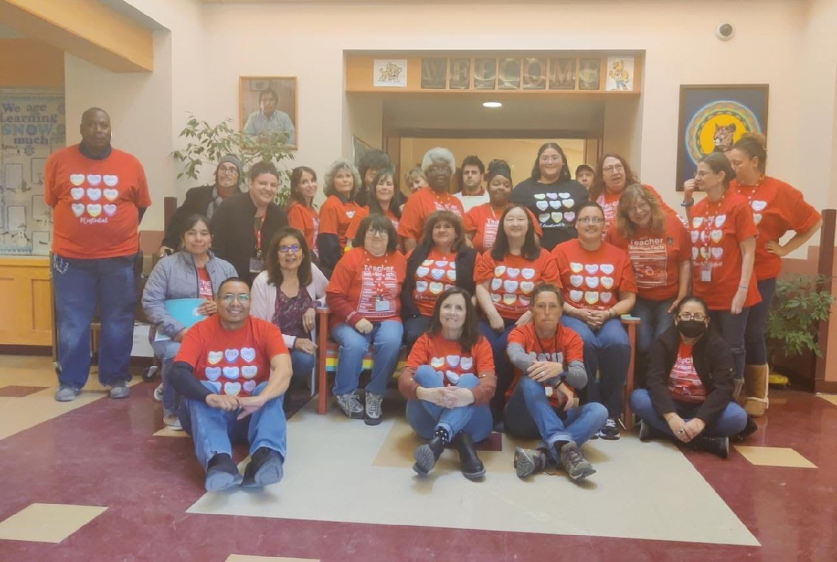
Conclusion
People working together in a strong community with a shared goal and a common purpose can make the impossible possible.

Slide 12
(K-5)
Student Data
(iMSSA)
MS Student Data
iStation K-5 Reading & Math (Sept. 2022-Feb.2023)
6th Grade iMSSA (22-23 BOY & MOY)
3rd Grade iMSSA (22-23 BOY & MOY)
7th Grade iMSSA (22-23 BOY & MOY)
4th Grade iMSSA (22-23 BOY & MOY)
8th Grade iMSSA (22-23 BOY & MOY)
5th Grade iMSSA (22-23 BOY & MOY)
MSSA/ASR (Spring 2022 6th Grade)
MSSA/ASR (Spring 2022 3rd Grade)
MSSA/ASR (Spring 2022 7th Grade)
MSSA/ASR (Spring 2022 4th Grade)
MSSA/ASR (Spring 2022 8th Grade)
MSSA/ASR (Spring 2022 5th Grade)

