Slide 1
Placitas Elementary School
Budget Proposal 2023-2024

Slide 2
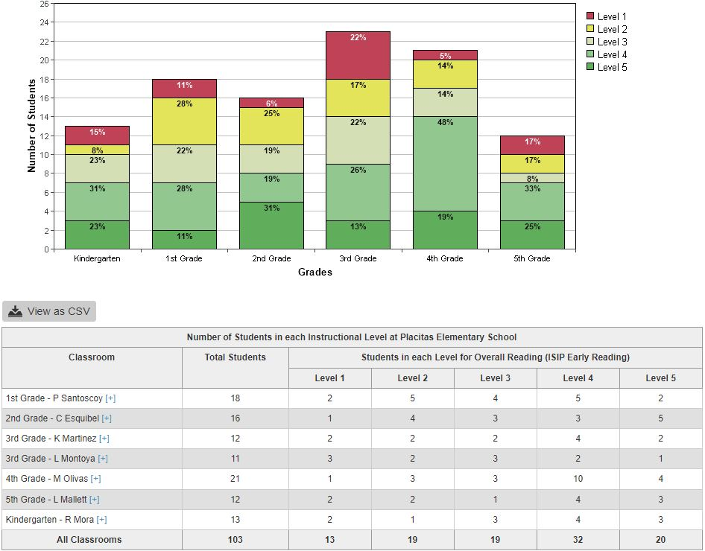
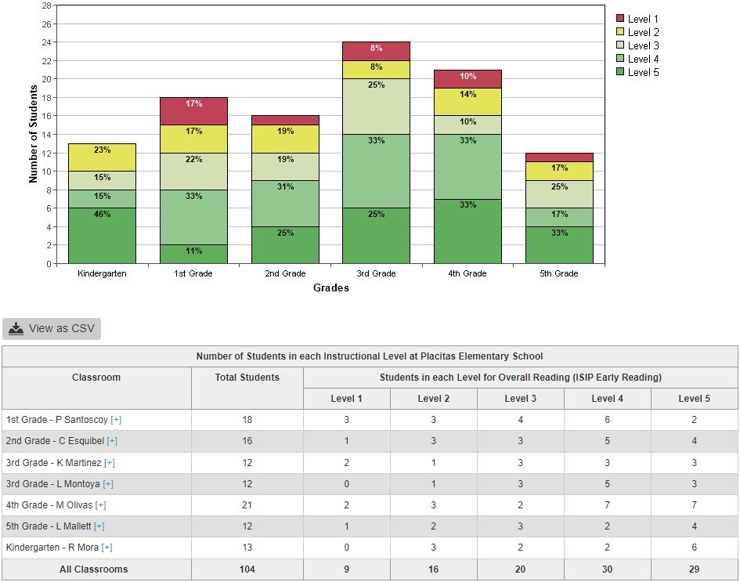
Reading BOY to MOY
BOY to MOY Schoolwide Average Growth: -7% reduction in Levels 1 & 2, +7% increase in Levels 3, 4, & 5, +6.2% increase in Levels 4 & 5
Why? How?
Intentionality! Strategic focus (90 Day Plan) on Layer I instruction, PLC data study, Layers II & III supports; plus Schoolwide SEL initiatives (Project Plan) restorative practices and supports, positive school culture, collective efficacy, and shared growth mindset.

Slide 3
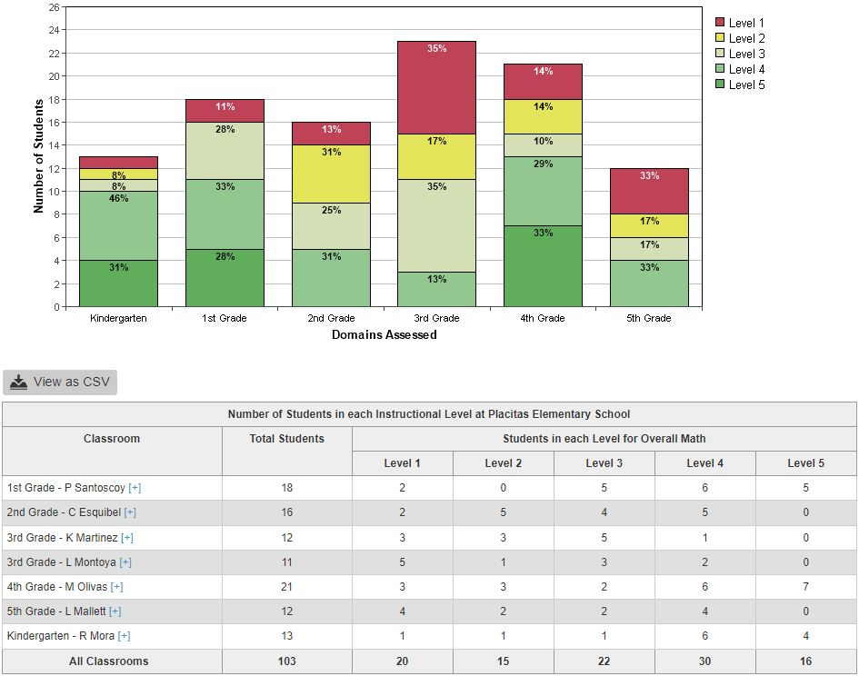
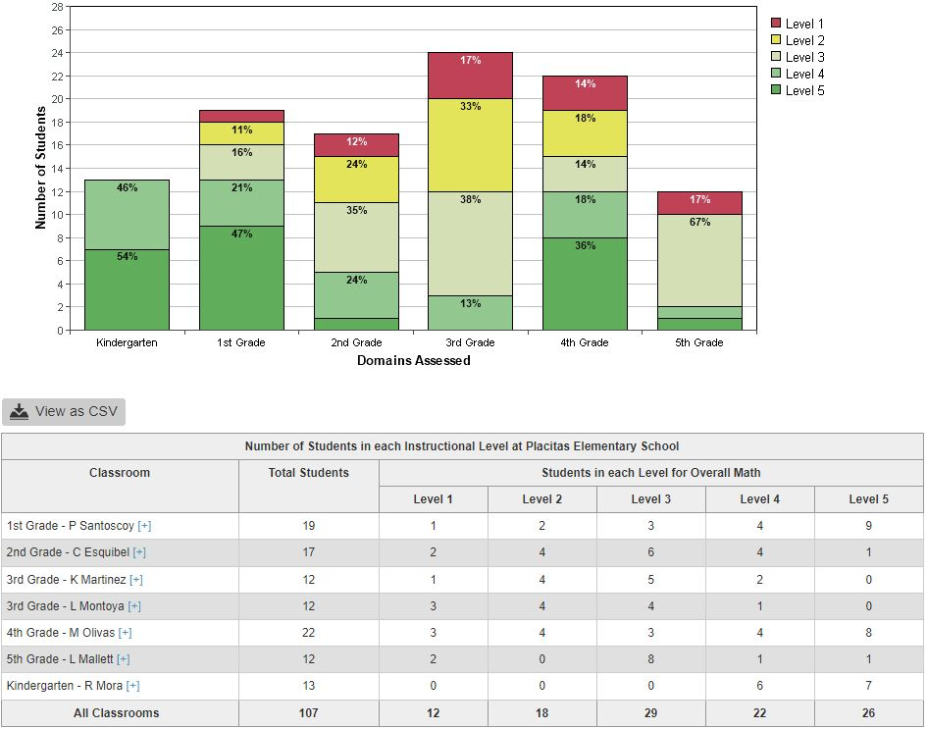
Math BOY to MOY
BOY to MOY Schoolwide Average Growth: -6% reduction in Levels 1 & 2, +6% increase in Levels 3, 4, & 5, +0.3% increase in Levels 4 & 5
Why? How?
Intentionality! Strategic focus (90 Day Plan) on Layer I instruction, PLC data study, Layers II & III supports; plus Schoolwide SEL initiatives (Project Plan) restorative practices and supports, positive school culture, collective efficacy, and shared growth mindset.

Slide 4
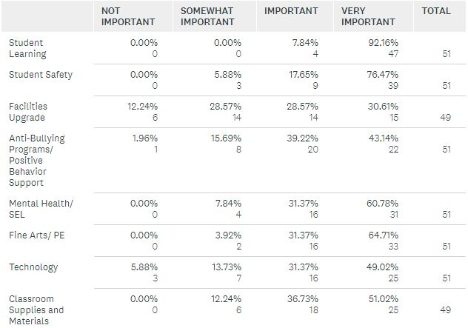
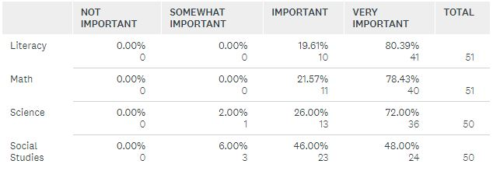
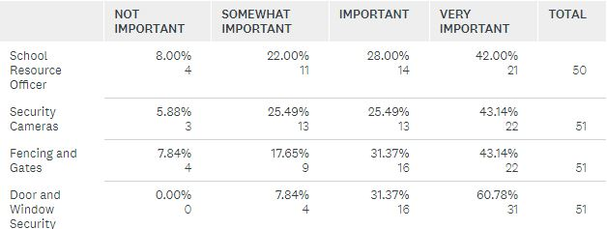
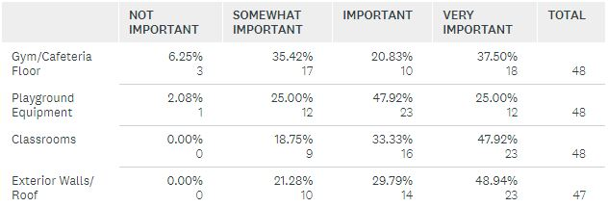
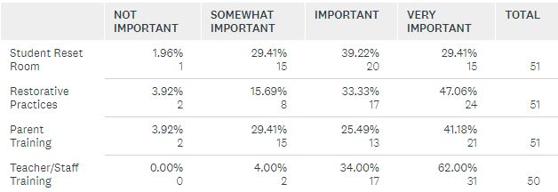
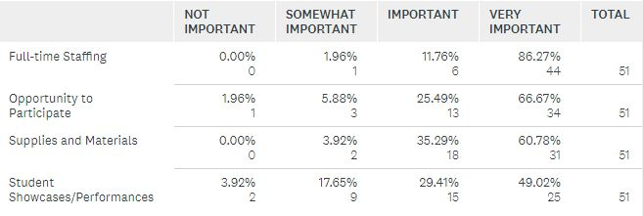
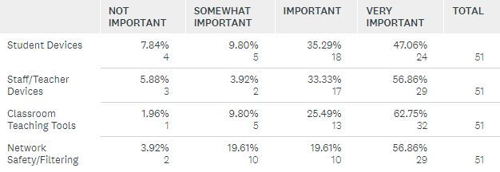
Staff & Community Involvement Survey Summary
Significant Findings:
(Important and/or Very Important rating)
100% Student Learning
96 % Fine Arts/PE
94% Student Safety
92% Mental Health/SEL
88% Classroom Supplies/Materials
80% Technology
Student Learning:
100% Literacy & Math
98% STEM
Student Safety:
92% Door & Window Security
70% SRO & Security Cameras
Facilities Upgrades:
81% Classrooms
79% Exterior/Roof
Mental Health/SEL
96% Staff Training
80% Restorative Practices
Fine Arts/PE
98% Full-time Staffing
96% Supplies/Materials
Technology:
90% Staff Devices
88% Instructional Tools
N=51, 51/81 PES families = 63%

Slide 5
Areas of Success Areas to Strengthen
Continuous School Improvement
Growth Mindset
School Climate
School Culture
Staff Efficacy
Collective Efficacy
90 Day Plan (Math & Reading, Layer I)
Project Plan (SEL)
Reading and Math Instruction (Layer I)
SEL/Restorative Practices (2023, Year 6)
Specials Teachers (Academic, Small Groups)
PLC Teams (Data/Planning)
LETRS (Classroom Teachers)
MLSS Coordinator/Team
IAs [SPED/Student Needs(4 FTEs)]
SPED Teachers (1.5 FTE)
PowerSchool/STARS
Fiscal Responsibility
Reading and Math Interventions (Layer II)
Writing
Continue Staff/Family SEL Training
PLC Teams (Lesson Planning)
LETRS (Specials Teachers)
Autism Spectrum + Down Syndrome Awareness/Strategies (All Staff)
STEM/STEAM
IEP Facilitator Compensation
After School (BGCCNM)

Slide 6
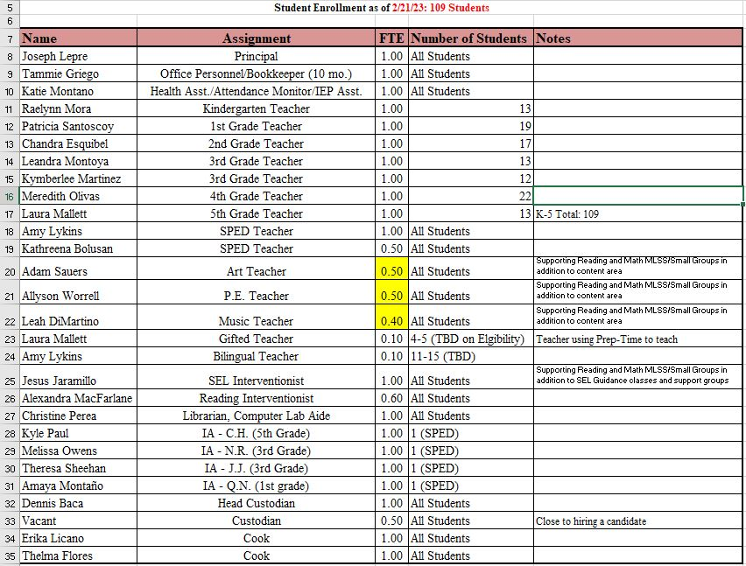
2022-2023 Staff FTEs

Slide 7
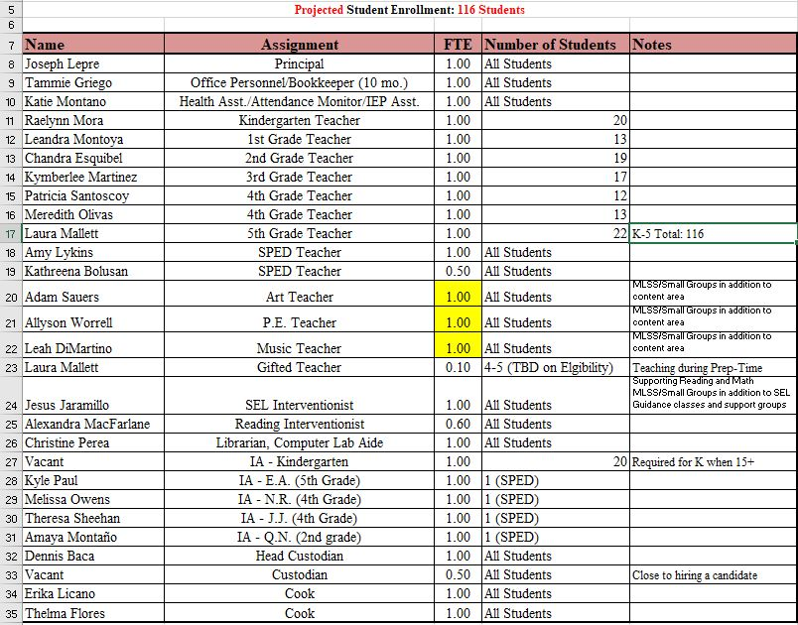
2023-2024 Staff FTEs

Slide 8
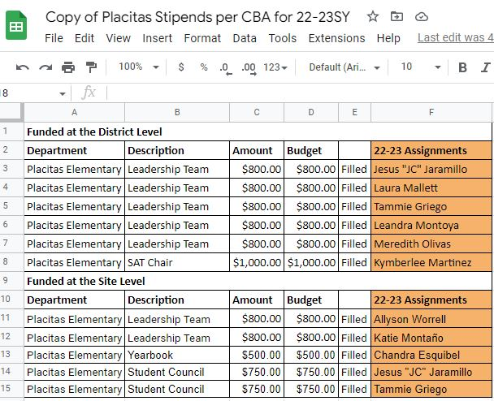
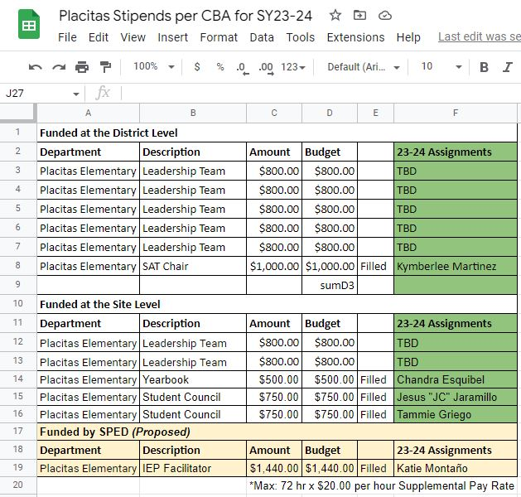
Stipends

Slide 9
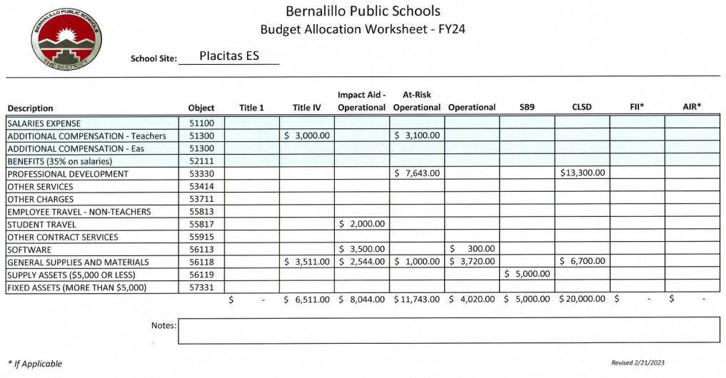
Budget Allocation Worksheet FY24

Slide 10
Needs & Big Asks
What/Who Why? How/$ Source
New Roof Leaks/Damage BPS/Facilities/Operations
New Gym/Cafeteria floor Safety/Events BPS/Facilities/Operations
Hallway “Lockers” Cubbies Safety/Morale BPS/Facilities/Operations
Camera/Alarm Systems Safety/Community BPS Board Safety Funds
SRO or Security Guard Safety/Community SCSO or BPS
SEL Interventionist (JC Jaramillo) SEL/Community ARP then ?
Full-time Art/Music/PE teachers Community/Opportunity BPS
Stipend IEP facilitator (Katie Montaño) Equity/Compensation SPED
Fresh Fruit and Vegetables (FFVP) Equity/Opportunity USDA/NMDA/BPS Food Services

