Slide 1
Bernalillo Elementary School
Budget Presentation

Slide 2
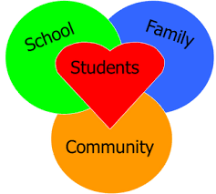
Staff and Community Involvement
February 2: Met with Leadership
What worked and what didn’t work
Needs for next year - with emphasis on student achievement and wellbeing
February 21: Optional staff meeting 3:45 in the library
Not mandatory
Option to still contribute to Padlet
February 26: Parent/Family survey (English/Spanish)
What is going well/ needs improvement
What can change/ add
Feedback and suggestions

Slide 3
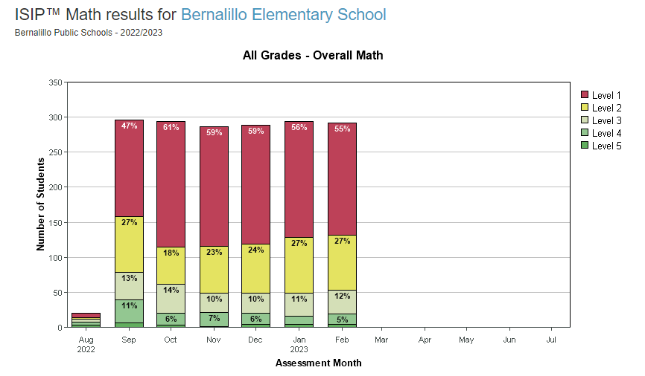
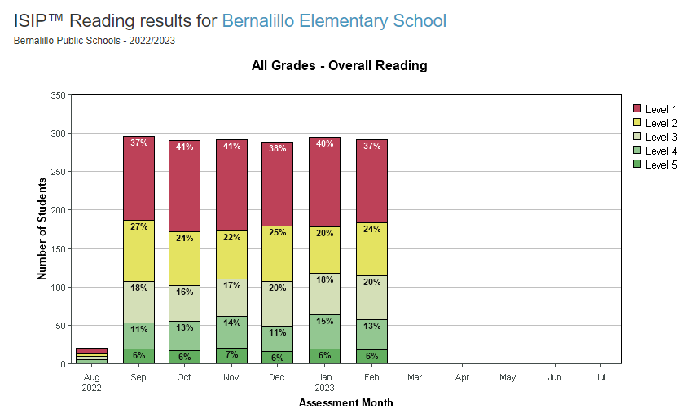
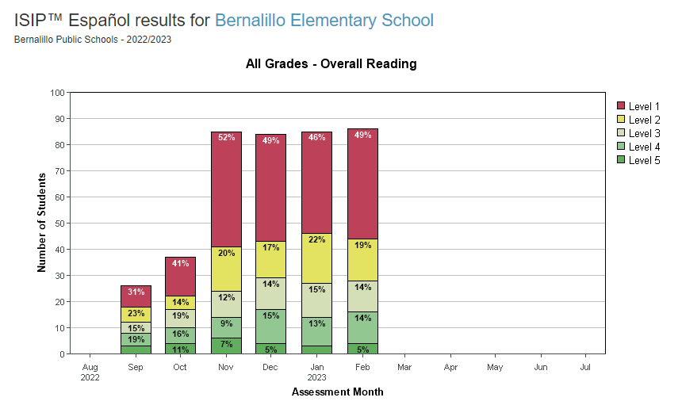
iStation Data
Grade Level Interventionists
RTI (60 min daily) + Enrichment time

Slide 4
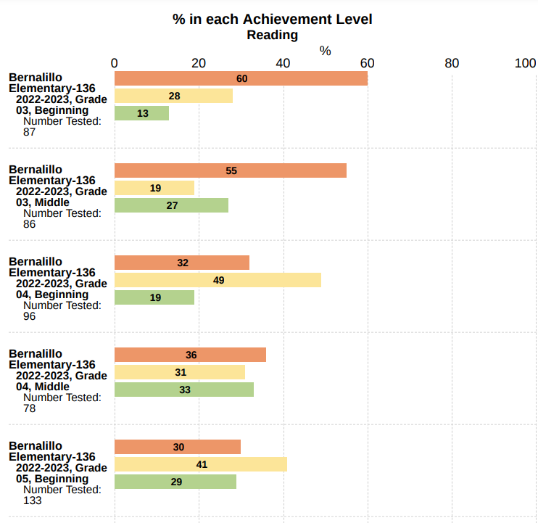
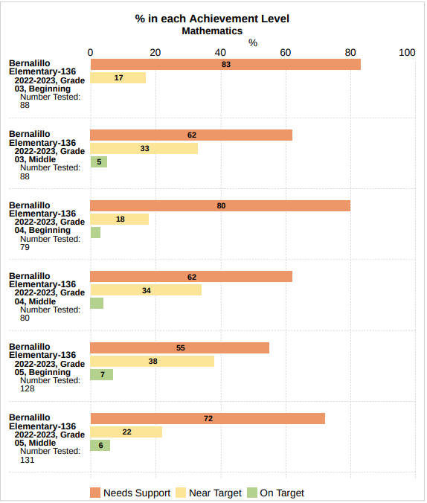
iMSSA Data BOY/MOY
Needs Support -5
Near Target -9
On Target +14
Needs Support -21
Near Target +16
On Target +5
Needs Support +4
Near Target -18
On Target +14
Needs Support -18
Near Target +16
On Target +2
Needs Support -3
Near Target +4
On Target -1
Needs Support +17
Near Target -16
On Target -1

Slide 5
3rd Grade | 4th Grade | 5th Grade | Specials | Interventionist
 | 86 (Dual 27) | 111 (Dual 32)
Acosta (Dual) | Maesta (Dual) | Leclerc (Dual) | Livingston (Music) | Madrid (3rd)
Cervantes (Dual) | Moreno (Dual) | Rinaldi (Dual) | Song (Art) | Cordova (4th) CLSD Braden (SEL)
Vigil | Herrera | Jean | Anita Jaramillo (Computers) | Herman (5th) Title 1
Silva | Vicenti | Chavez | Edwina Tafoya (Library) | Furby (Math/SAT/504)
Tansey | Cordova (4th) CLSD | Curliss | Rick Romero (PE)
Nielsen (Sped) | Arellano (Sped) | Lopez (Sped)

Slide 6
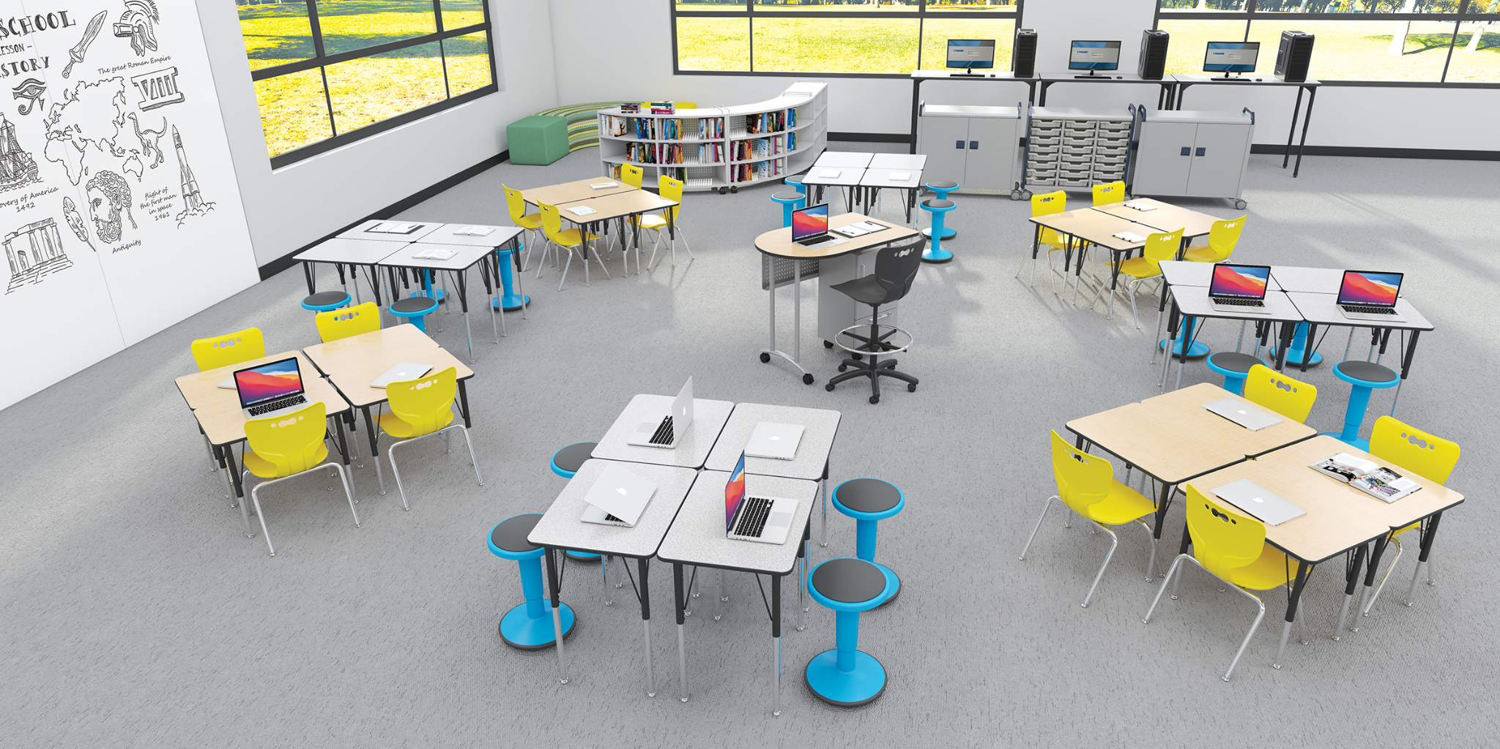
Professional Development
Supply/Fixed Assets
Additional Compensation
Savvas
Successmaker
PLC Training
Differentiated Instruction (based on data)
Trauma Informed Learning
Safe School Ambassadors
Restorative Practices
Safety Training
Inclusion
Beable
PLTW
MLSS
SAT
Update student desks, tables, and chairs
Additional swing set
Awnings in bus and parent pick up area
Flexible seating options for the classrooms, library, and hallways
Large rugs for classrooms
Before/ After school tutoring & clubs
Leadership
Planning and preparing for school year
Behavior redirector
Selling prep for enrichment

Slide 7
Safety
Curriculum/Software
Supplies and Materials
Student Transportation
Cameras
Radios
Security gates (open only from inside)
Bullet proof film on windows (inside and outside)
BES SRO On- Site
Savvas
Successmaker
iStation
Beable
Intervention Program (TBD)
Quaver (Music)
Art
Nearpod
Caring Communities
Science room supplies and materials
Art Room supplies and materials
Classroom supplies and materials
Office supplies and materials
2-3 Field Trips per grade level
After school programs

Slide 8
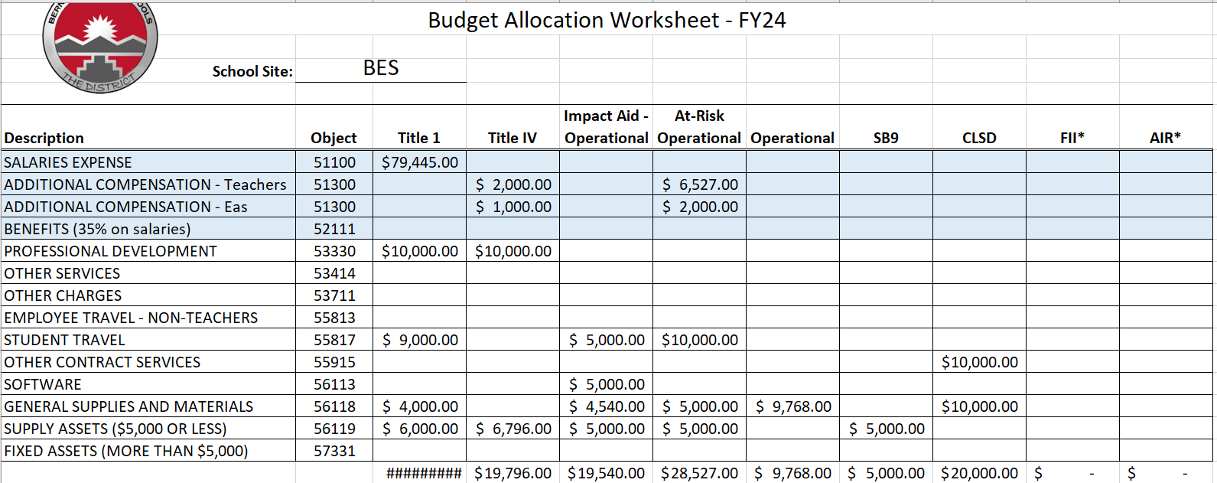
Budget Allocations
Request: 0.5 position

