Slide 1



Budget Kickoff Training
2/1/2023
Bernalillo Public Schools

Slide 2
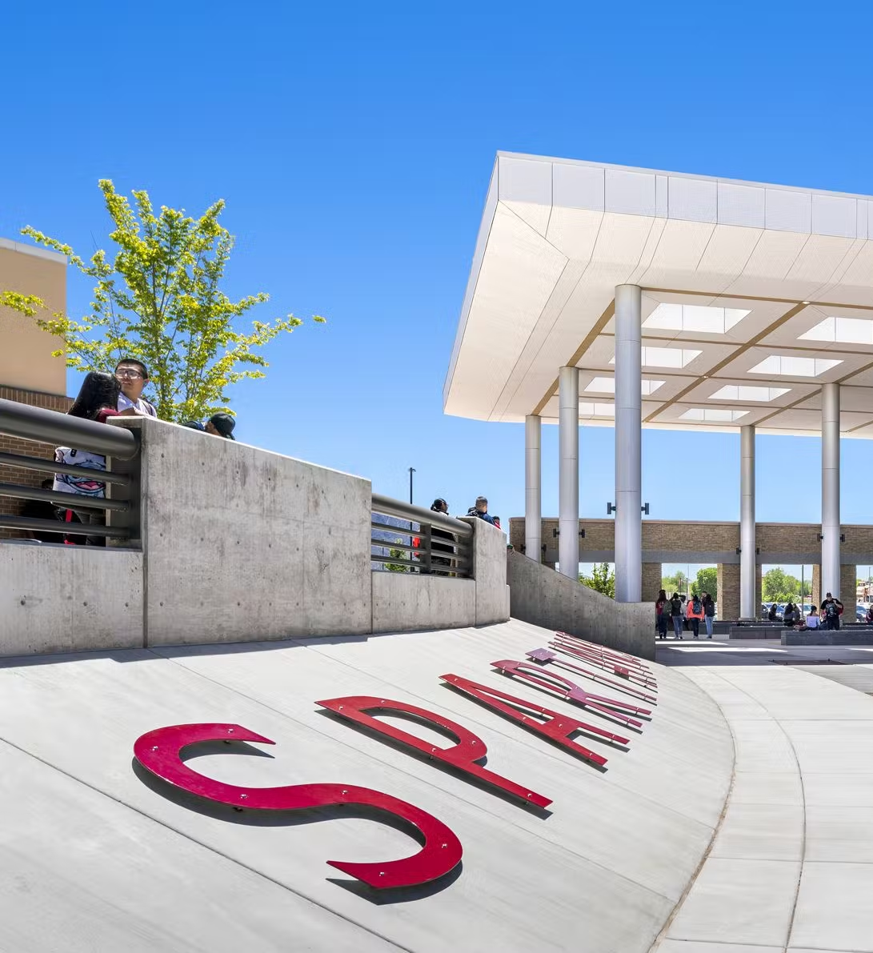
Vision:
Bernalillo Public Schools
How can a budget help or hurt a school or department?
Notes:
Right click the photo to replace it with another photo of your choice

Slide 3
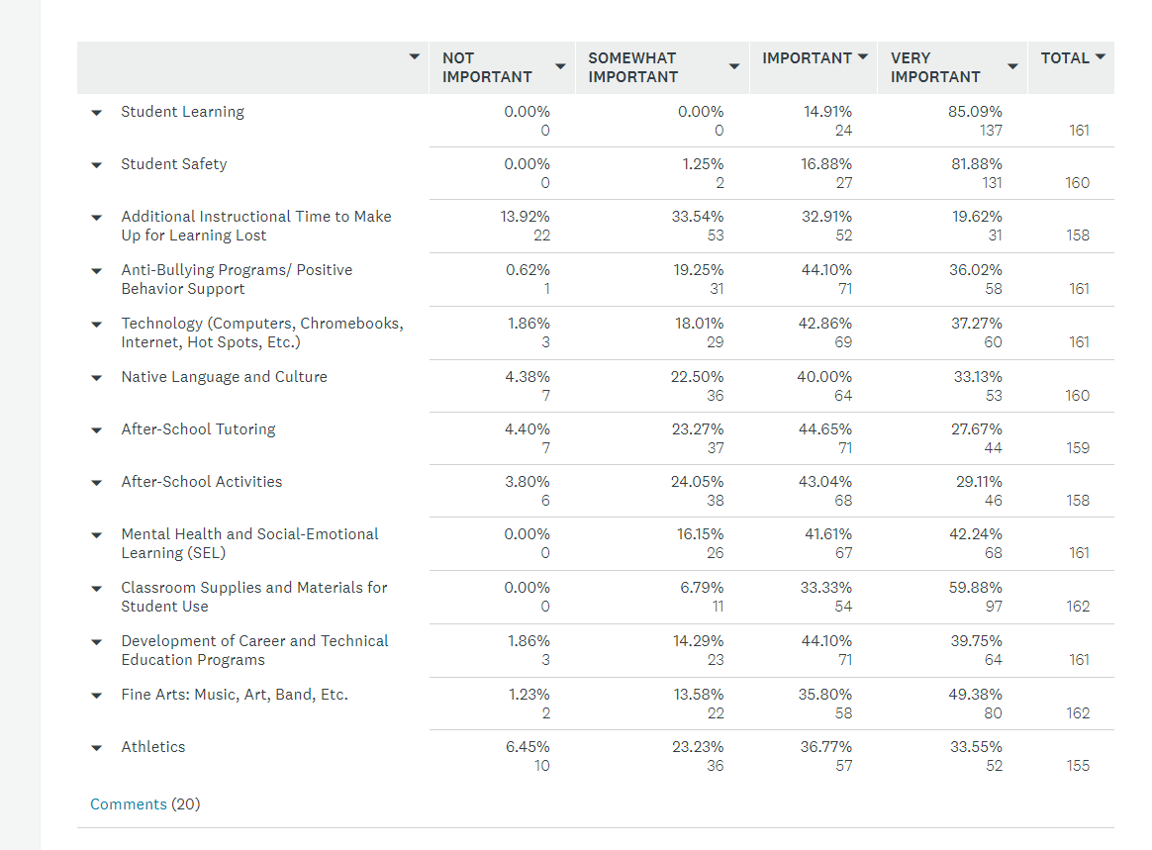
District Budget Survey

Slide 4
Agenda
Timeline
1
2
Building Budget
Involving Stakeholders
3
4
District Budget Meeting
Athletics
5
Bernalillo Public Schools
Notes:
You may delete any elements (items) you need to suit your personal agenda so long as you made a copy of the template.

Slide 5
School Budget Timeline
Feb 1 – Budget Kickoff Meeting
Feb 2- 26 Budget Creation
Feb 2-26 Community Input
Feb 27 – Mar 10
Budget Presentation
May
Submission of Budget to Board

Slide 6

Building Your Budget
Plan Your Budget
VS
Budget Your Plan
Bernalillo Public Schools
Notes:
Right click the photo to replace it with another photo of your choice

Slide 7
What should drive your budget?
The kids
Your school improvement plan
Real needs
What is working!

Slide 8

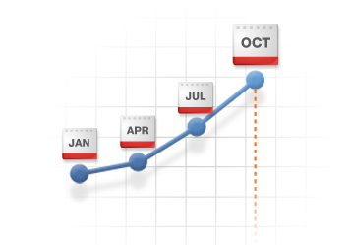

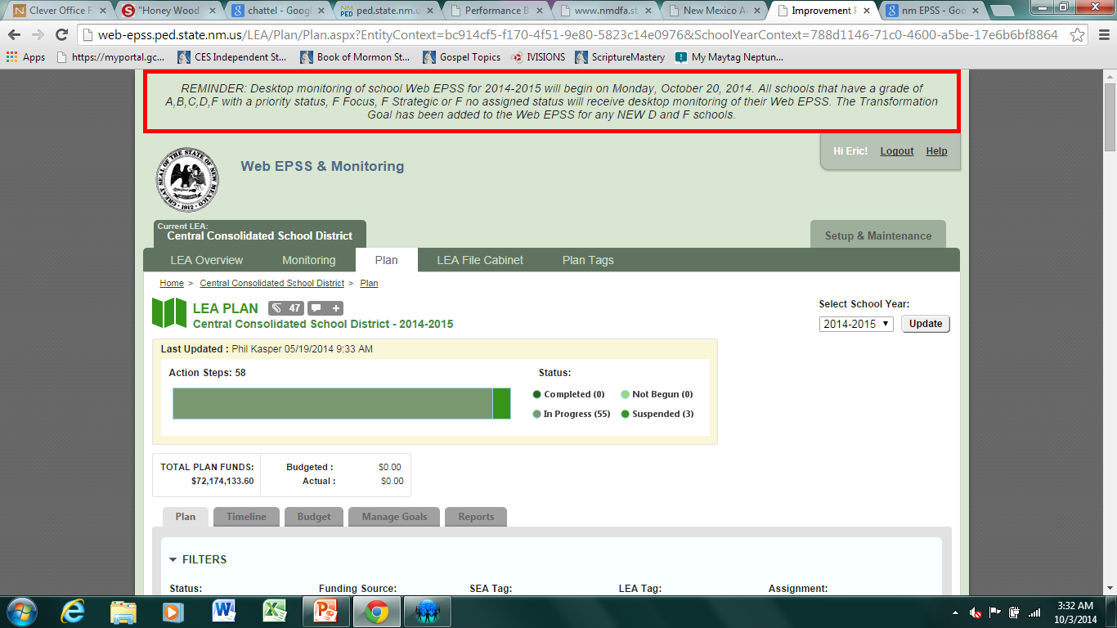

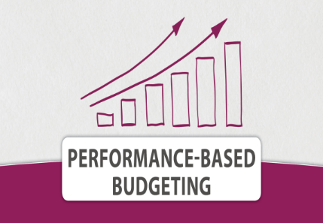
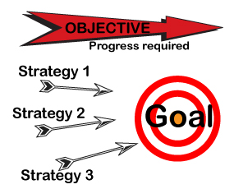
MAY
MAR
OCT
DEC
Quarterly Monitoring
Performance –Based Budgeting is the Focusing of Assets
on Site Goals

Slide 9

Is there more than one way to budget?
Bulimic Budgeting
King’s Budgeting
Zero-Based Budgeting
Performance-Based Budgeting

Slide 10
Bulimic Budgeting
You regurgitate last year’s budget
Plus: Fast and easy. Pull a principal’s report and fill in the numbers.
Minus: Not very needs based. No input. No buy-in. No good.

Slide 11

King’s Budgeting
The “King” (principal) decides who gets what, when, and why.
Plus: Easy. No meetings, haggling, or pressures to make the “Big King’s” (Bye) deadline.
Minus: May only have a perceived sense of reality. Easy to play favorites. No good.

Slide 12
Zero-Based Budgeting
All previous expenses are scrapped and team starts with no budget items. Every item is added competitively.
Plus: Creates a very detailed budget tied to needs and school improvement plan that gets buy-in from all parties. Can be very good blueprint for school.
Minus: Time consuming. Can be very difficult in first year or two. Not a lot of flexibility for changes in following year.

Slide 13

Performance-Based Budgeting
Programs that are doing well are strengthened or expanded. Programs that are not showing positive effect are terminated or revised.
Plus: Virtually guarantees a positive return on investment and that the plan benefit students.
Minus: Requires time and effort to make data-informed decisions.

Slide 14


Involving Stakeholders
Leadership Team
School Staff
Students
Community

Slide 15


District Budget Meeting
1. Report on data, what worked, what did not, and 2023-2024 site plan (Max 8 slides).
2. Staff and Community involvement in budget planning (1 slide)
3. Allocation BAR for each fund awarded using 2022-2023 amounts.
4. ATHLETICS:
a. Expense estimate for each sport using the district budgeting spreadsheet
b. Equipment and uniform rotation for six years

