Slide 1
Algodones Elementary
2023/2024
Budget Proposal

Slide 2
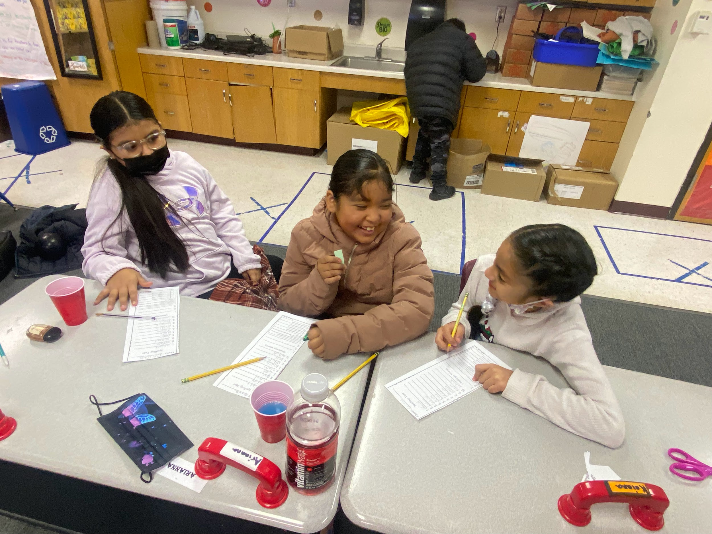
Our Why
We believe in student and staff success through the value of culture, language, high learning expectations.
Data
Access
85 Emerging Bilinguals
81 IFEP
1 student exited the Access Assessment
Istation
12% are proficient in reading, 88% are reading below grade level
11% are proficient in math, 89% are below grade level
Student Work
Classroom Observations

Slide 3
What Worked and What Did Not Work?
What Worked:
Access to SAVVAS materials
PD on how to utilize materials within the 90 minute block
Running Medicine
PBIS-Mustang bucks
Replenishing materials and supplies (staff morale)
What Didn’t Work
Operating in Isolation
Lack of input or awareness of purchases made
Utilizing computer programs for interventions
Minimal teacher feedback -data, SOR strategies
Purchasing programs, tokens, etc. without mapping implementation process
Who is responsible for driving the initiative/ timeline?
How will it make an impact on student learning

Slide 4
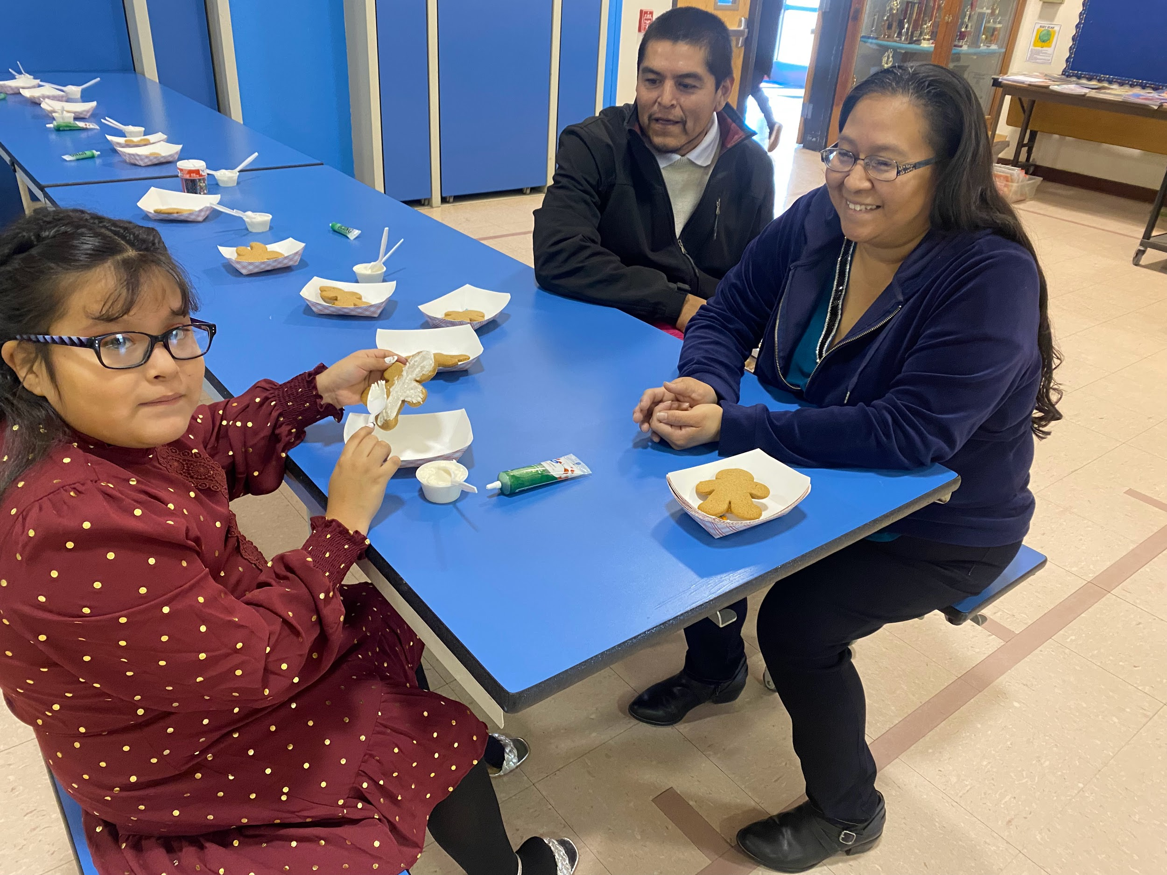
How:
By building capacity, a community of learning based on the needs of the students and community.
Focus on the knowledge and skills teachers need based on student data, and the needs of the families
Reading and Math: Foundational skills
SOR implementation in the classroom
math foundational skills
Proper time for learning and implementation (training within the school day and compensation for PD after the school day)
Tutoring and club programs
Parenting workshops and childcare
School wide SEL program
Enrichment activities
Field trips
Performances
Full time Educational Assistant

Slide 5
Algodones Elementary 2023/2024 Staff
Teachers
Kindergarten:
Ruth Miyagawa, Lisa Cisneros
First Grade
Emilie Sederholm, Sara Hinze
Second Grade
David Jaramillo, Vacant
Third Grade
Kristal Martinez, Wendy Dostart
Fourth Grade
Deborah Hill, Lisa Thomason
Special Education
Anthony Uy, Justice Vazquez
Specials
Adam Sauers ½
Allyson Worell ½
John Yu
Educational Assistants
Kindergarten:
Shyanne Alarid, Vacant
Keres
Jenilee Sandoval ½ Keres, ½ SpEd
Special Education
Holly Mares (½ Library) , Sarah Gallant
Vacant
Long Term Substitute
Larry Gilbert
Support Staff
Counselor:
Katrice Grant,
Social Worker:
Mary Schmauss
Reading Interventionist:
Vacant 1.0
Nurse
Meghan Dozal
Administrative Assistant
Sharon Herrera
Bookkeeper
Jacqueline Trujillo
Custodians
Lawrence Garcia, Armando Ruiz ½

Slide 6
Budget Allocation
Staffing and Support
Student Programs/
Enrichment
SEL Support
Supplies and Materials
Tutoring
Field Trips
Transportation
Science fair, programs
Running Medicine
SEL Curriculum
Parent workshops
Childcare
Food for staff and school events
Contract services:
May Center
Math Coach-Contract
Staff:
Educational Assistant
FTE: Music Teacher
Replenish materials and supplies
Furniture

Slide 7
AES 2023/2024 Proposed Budget
Reading and Math Foundational Skills:
May Center Contract Total $25,000: $18,332 FII, $6,668 CLSD
Math Coaching Total $14,193: $1,260 Operational, $12,933 FII
Staff:
Educational Assistant $33,750: $25,000 + $8,750 Title I
Full Time Music Teacher $37,800: $28,000 $4,200 Title I
Additional Compensation
Tutoring $25,000 +35%: $25,000 (+$8,750) FII
Stipends $7000 +35%: $9,450 Impact Aid
Student Programs/Enrichment:
Field Trips, Presenters: $5,000 FII
Transportation (FT) $7500: $6,240 FII, $1260 Operational

Slide 8
AES 2023/2024 Proposed Budget
SEL Support:
SEL Curriculum $5397: $1260 Operational, $2900 IDEA B, $1237 Title IV
Parent Workshops
Childcare $3000+35%: $4050 Title IV
Trauma Informed Training (staff): $1500 Title IV
Running Medicine: $1760 Title I
Food for Parent Workshops/Trainings $1360: $550 Impact Aid, $810 Title IV
Mustang Store PBIS: $561 Title IV
Supplies and Materials
SOR Materials and books: CLSD $13,332
General Supplies: $5,003 At Risk Operational, $1260 Operational,
Supply Assets (furniture): $5,000 SB9
*Wish list: transportation for after school programs, (FTE) math interventionist, part time gardening teacher, Discovery Ed

Slide 9
Proposed Schedule:
2023/2024 Schedule

